Slide 1
RICHARD 4 ENGLISH
NO FEAR, NO FRILLS
ENGLISH TIPS FOR ENTHUSIASTS

Slide 2
WHO IS RICHARD?
BORN ENGLAND 1966
BROUGHT UP IN LINCOLNSHIRE
UNIVERSITY OF EDINBURGH, MASTERS DEGREE IN RUSSIAN LANGUAGE AND LITERATURE
CELTA TEACHING QUALIFICATION
SPEAK RUSSIAN, FRENCH AND SPANISH, LEARNING OTHERS!
20 YEARS IN INTERNATIONAL BUSINESS
TEACHING FOR 15 YEARS
VISITED 90 COUNTRIES AND LIVED IN 16
I AM A PUBLISHED AUTHOR AND A RETIRED AMATEUR JUMP JOCKEY!

Slide 3
MY INTERESTS APART FROM LANGUAGES!

Slide 4
WHY AM I HERE?
TO GIVE PEOPLE A CHANCE TO LISTEN AND SPEAK WITH A NATIVE BRITISH PERSON
TO SHOW YOU WHAT IS REALLY IMPORTANT WHEN LEARNING ENGLISH, AND WHAT IS NOT
TO EXPLAIN A LITTLE ABOUT BRITISH PRONUNCIATION AND WHERE ENGLISH COMES FROM AND WHY IT CAN BE A VERY FRUSTRATING LANGUAGE TO LEARN
TO GIVE TIPS ON SOUND, VOCABULARY, GRAMMAR AND EXAMS
A FEW WORDS ON OUR ODD BRITISH TRADITIONS
TO HELP YOU OVERCOME YOUR FEAR OF SPEAKING AND MAKING MISTAKES

Slide 5
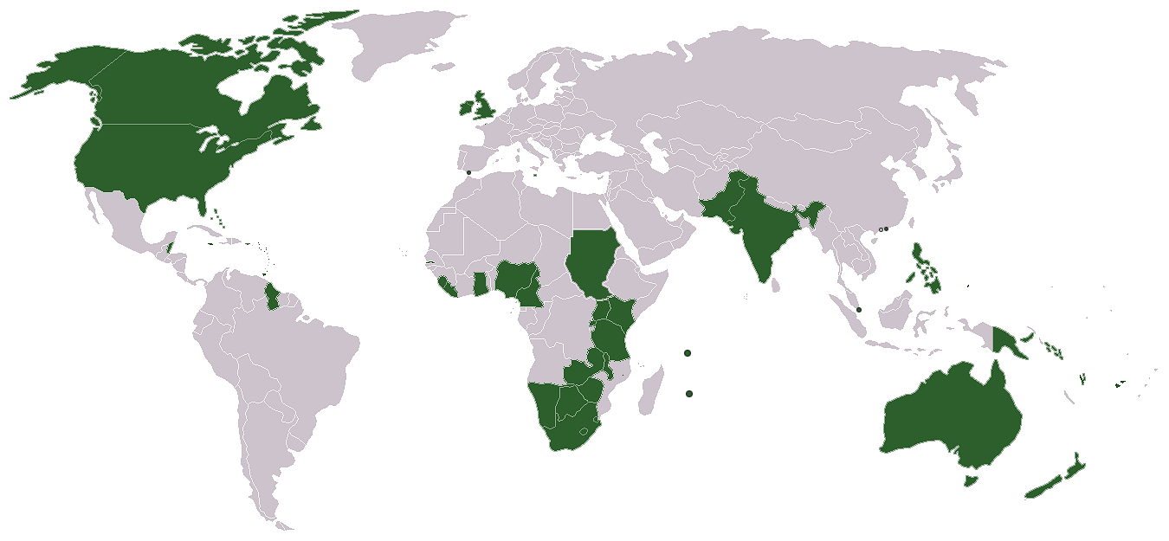

Slide 6
AN INTERESTING FACT…
ENGLISH IS THE OFFICIAL, LEGAL LANGUAGE IN 81 COUNTRIES AND TERRITORIES, BUT NOT IN UK OR USA!
THERE IS NO OFFICIAL BODY TO SAY WHAT IS AND ISN’T ENGLISH, UNLIKE FOR UKRAINIAN, RUSSIAN, FRENCH, SPANISH AND MANY OTHER LANGUAGES. THIS MEANS…..

Slide 7
THERE ARE NO RULES!
There are only conventions!

Slide 8
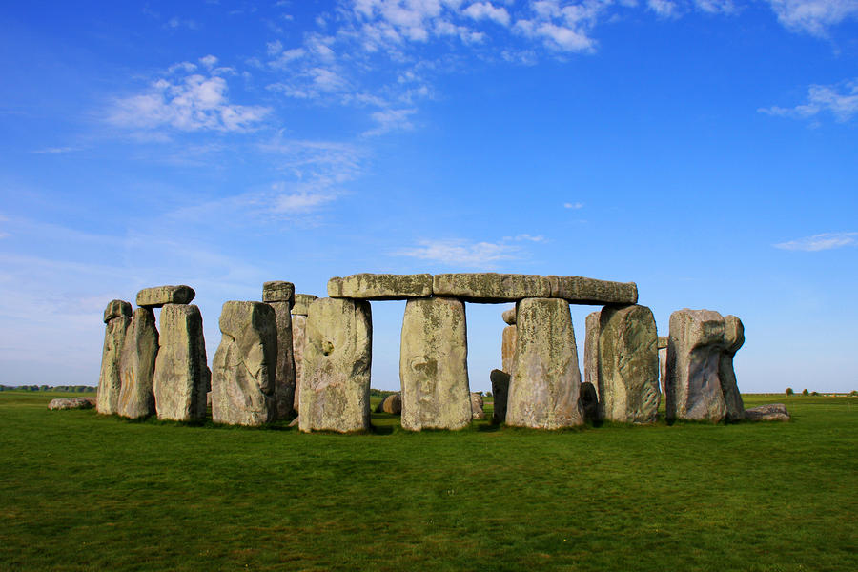
THE BRITONS, WERE THEY THE FIRST SPEAKERS OF ENGLISH?
THE CELTS, WHERE ARE THEY NOW?
THE ROMANS, WHAT DID THEY EVER DO FOR US?
THE ANGLES AND SAXONS, BUT WHAT EVER HAPPENED TO THE JUTES? THE BIRTH OF A LANGUAGE
THE NORSEMEN WITH THEIR LONGSHIPS AND SHORT WORDS
WILLIAM THE CONQUEROR AND THE BIRTH OF MIDDLE-ENGLISH

Slide 9
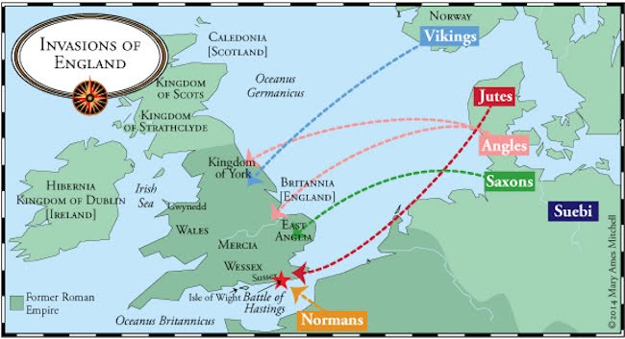

Slide 10
QUESTION: WHAT IS THE MOST IMPORTANT ASPECT OF GOOD ENGLISH? IS IT:
Grammar?
Vocabulary?
Syntax?
Pronunciation?
Accent?
Something else?
The answer is: ________________

Slide 11
INTONATION
WHAT YOU DO WITH YOUR VOICE IS THE MOST IMPORTANT THING FOR MAKING SURE PEOPLE KNOW EXACTLY WHAT YOU WANT OR MEAN

Slide 13
DEFINITELY, NOT THE QUEEN’S ENGLISH!

Slide 14
THE IMPORTANCE OF INTONATION IN ENGLISH
If the parts of speech and vocabulary are the meat and drink of English, then intonation is the seasoning, the spice, the colour and the flavour. Without it, there is nothing but a bland and tasteless dish.
Why do we speak?
How we listen to English?
How to make your words count?

Slide 15
PRONUNCIATION
Mouth mobility
Smiley people speak better English, ship and sheep
Where does your voice come from
Get that tension in your lips
Force the air out, don’t let it just fall
Long syllables are short, short syllables are very, very short
Shwa “ə” bananə BUT bananerice-cream. This is part of…
Connected Speech Gowaway, Djə wanna coffee?

Slide 16
A Thousand Hairy Savages, Spike Milligan
A Thousand hairy savages Sitting down to lunch Gobble, gobble, gulp, gulp Munch, munch, munch.

Slide 17
WHAT DOES A NATIVE SPEAKER SAY?
Yesterday, I went to the supermarket, and I bought some French bread, some Irish Cheese and a bottle of red wine

Slide 18
WHAT DOES A NATIVE SPEAKER HEAR?
Yesterday, supermarket, French bread, Irish cheese, red wine

Slide 19
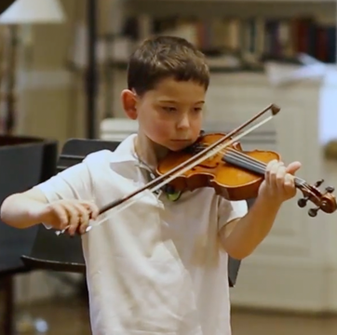
CHANGE THE INTONATION, CHANGE THE EMPHASIS
My brother plays the violin in the kitchen every Thursday evening

Slide 20
HOW TO MAKE PEOPLE LISTEN TO YOU IN ENGLISH
Speed kills
Pauses are your friend
Speaking is singing
Speaking is selling
Grammar is a distant second to sound
Speaking freely is more important than speaking fluently or accuracy

Slide 21
VOCABULARY AND GRAMMAR
Learn lists of words every day
Learn between 30 and 50 words every day
Always put the translation down next to the English
Learn the grammar rule off by heart and write out the sample sentences several times
THEN…..

Slide 22
SHOOT YOURSELF!
Learn one or two new words every day if you have time
Always write them down but highlight them in a sentence to show their meaning
Make the examples about you and your life
Never write down the translation. Write the definition in English if you wish. Play the game, Taxi
Practise the sound, spelling and use. Remember the spelling and the sound may have little to do with each other
To remember a word or rule forever, teach it to someone else

Slide 23
ENGLISH SPELLING IS NOT PHONETIC. WORDS ARE SYMBOLS
ENGLISH ENGINE
WOMAN WOMEN
COUGH TOUGH
PEACE PIECE
CAUGHT COURT
WON ONE
JOHN HAD TWO HORSES IN TWO RACES ON THE SAME DAY. ONE WON ONE AND ONE WON ONE TOO!

Slide 24
IDIOMS AND PHRASAL VERBS
Make them fun
Photograph or Film them (vidioms)
Act them out
Only learn the ones you like

Slide 25
VIDIOMS VIDEO IDIOMS AND PHRASAL VERBS

Slide 27
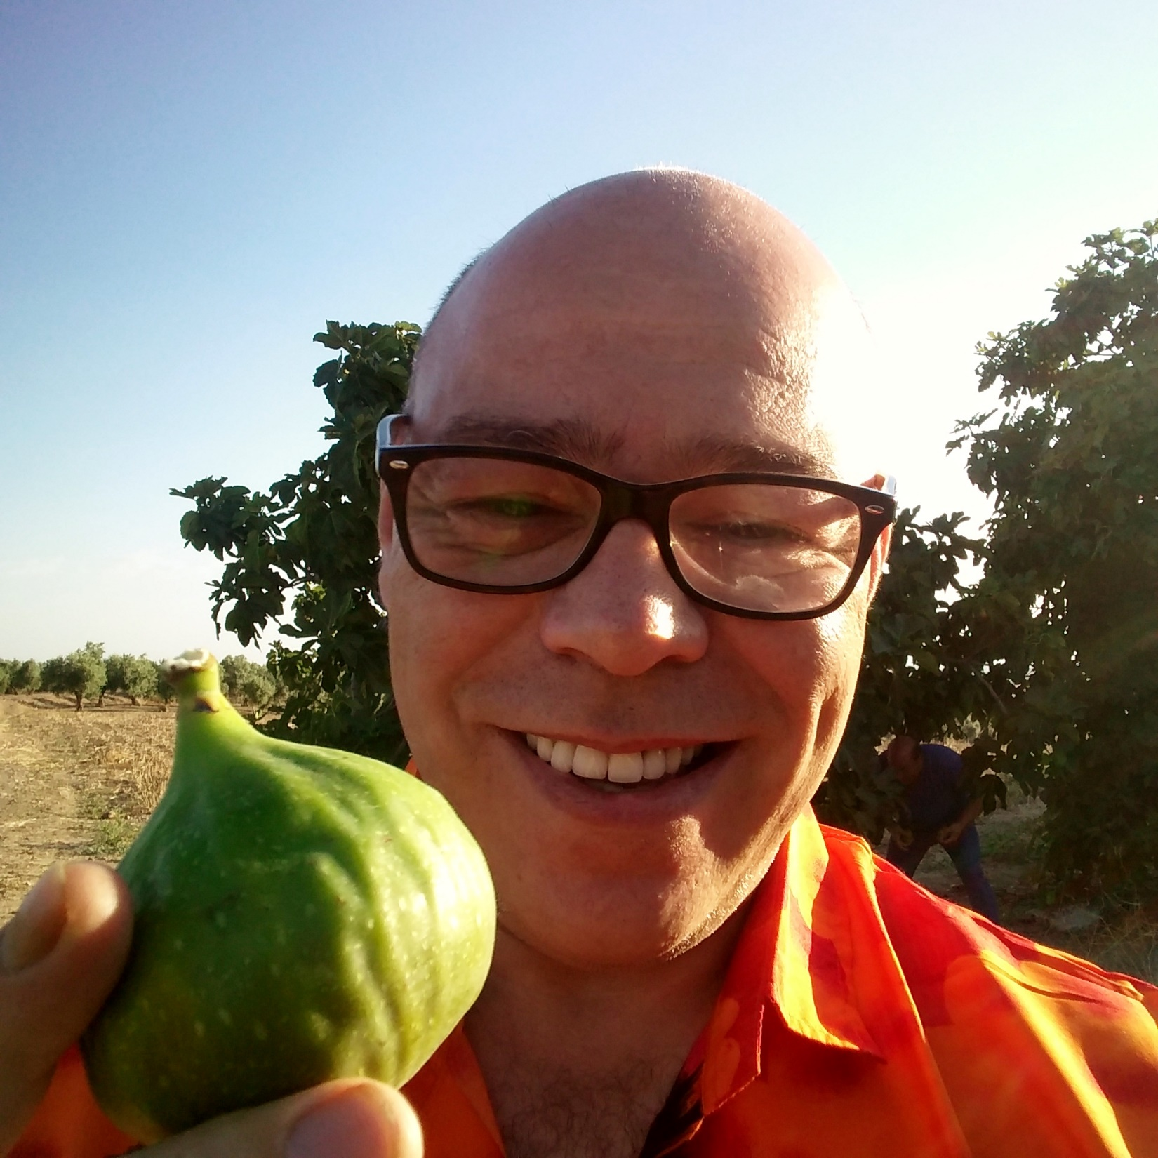

Slide 28
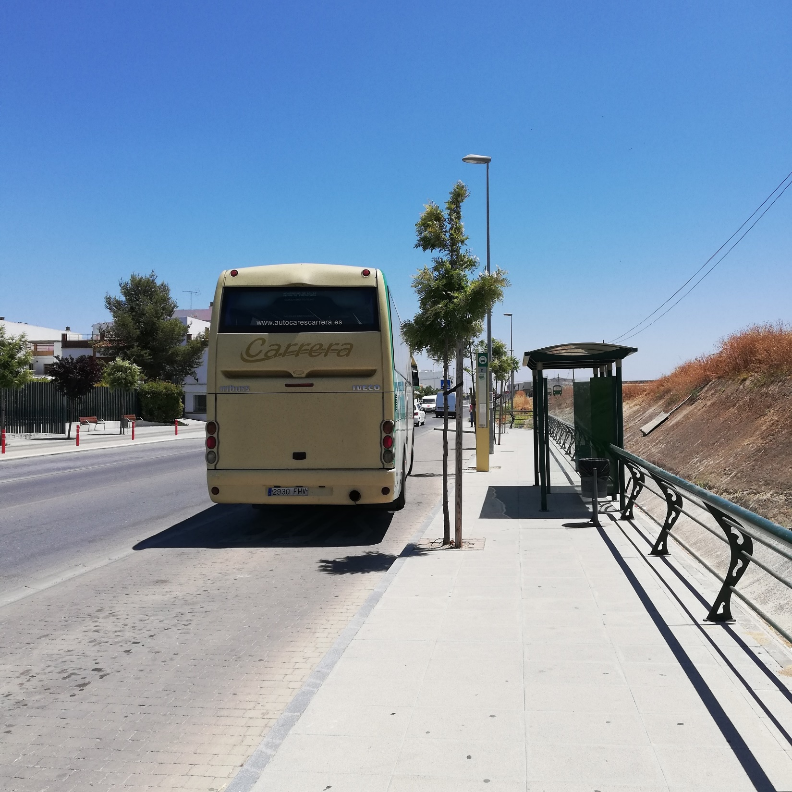

Slide 30
WHAT EXAMINERS WANT
What they don’t care about is how clever you are
Don’t waste time on the intellectual content of your writing, or speaking
Concentrate of producing the best English you can
Avoid or eliminate basic (silly) mistakes and you add 10%, at least to your score
Remember your word order, subject, verb, object
The passive is your friend
Have one inversion and one second, third or mixed conditional at the ready
Adjectives and adverbs use up words

Slide 31
FEAR IS NOT AN OPTION
What happens to our voice when we are nervous
Remember to breathe
Relax your shoulders
Remember why you are speaking
Make English part of your “me time” for leisure. Don’t make it a chore
Listen to clips of modern native English speakers or read how they tweet and feel better

Slide 32
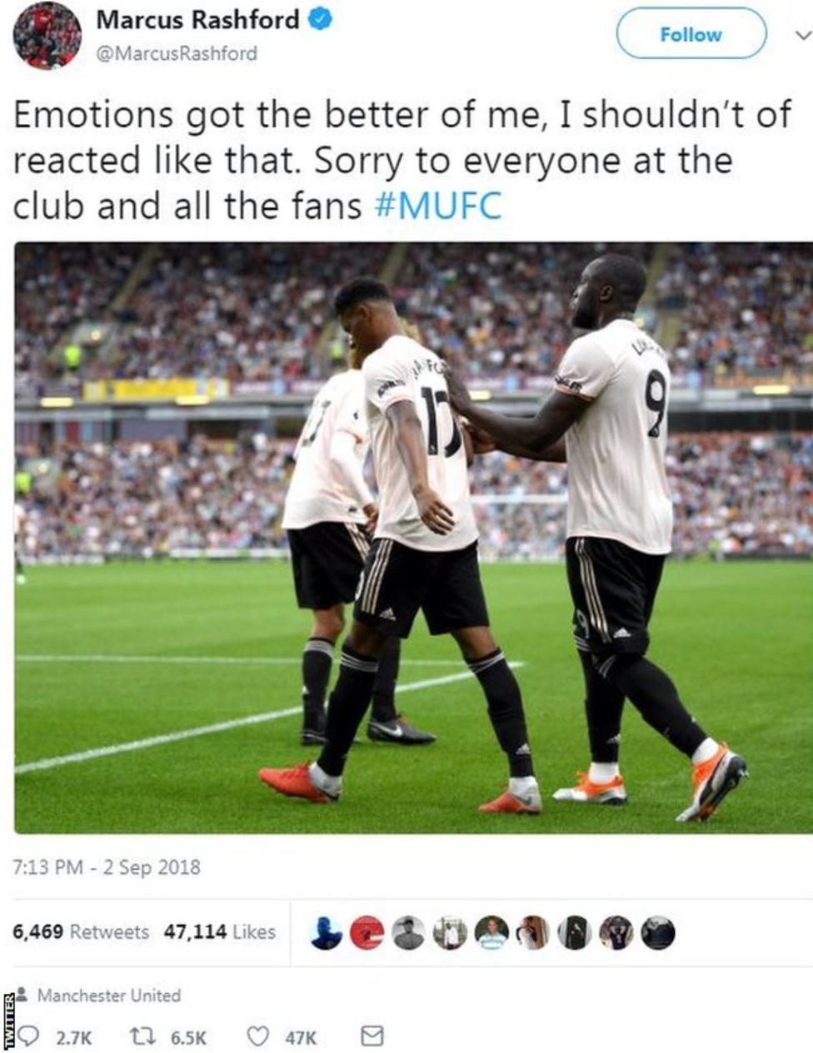

Slide 33
JABBERWOCKY, LEWIS CARROLL, EXTRACT
'Twas brillig, and the slithy toves
Did gyre and gimble in the wabe;
All mimsy were the borogoves,
And the mome raths outgrabe.
"Beware the Jabberwock, my son!
The jaws that bite, the claws that catch!
Beware the Jubjub bird, and shun
The frumious Bandersnatch!"

Slide 34
ODD BRITISH PLACENAMES
SHORTEST PLACENAME IN BRITAIN:
AE
LONGEST PLACENAME IN BRITAIN:
Llanfairpwllgwyngyllgogerychwyrndrobwllllantysiliogogogoch
LONGEST NAME THAT DOESN’T REPEAT A LETTER:
BUCKFASTLEIGH
ONLY NAME IN BRITAIN WITH AN EXCLAMATION MARK AS PART OF THE NAME:
WESTWARD HO!

Slide 35
AND FINALLY…
Remember, people will only think you are stupid…..if you are stupid, never for making a mistake.
NEVER, EVER APOLOGISE FOR MAKING A MISTAKE IN ENGLISH (Although, do apologise if you spill coffee on your teacher!)

Slide 36
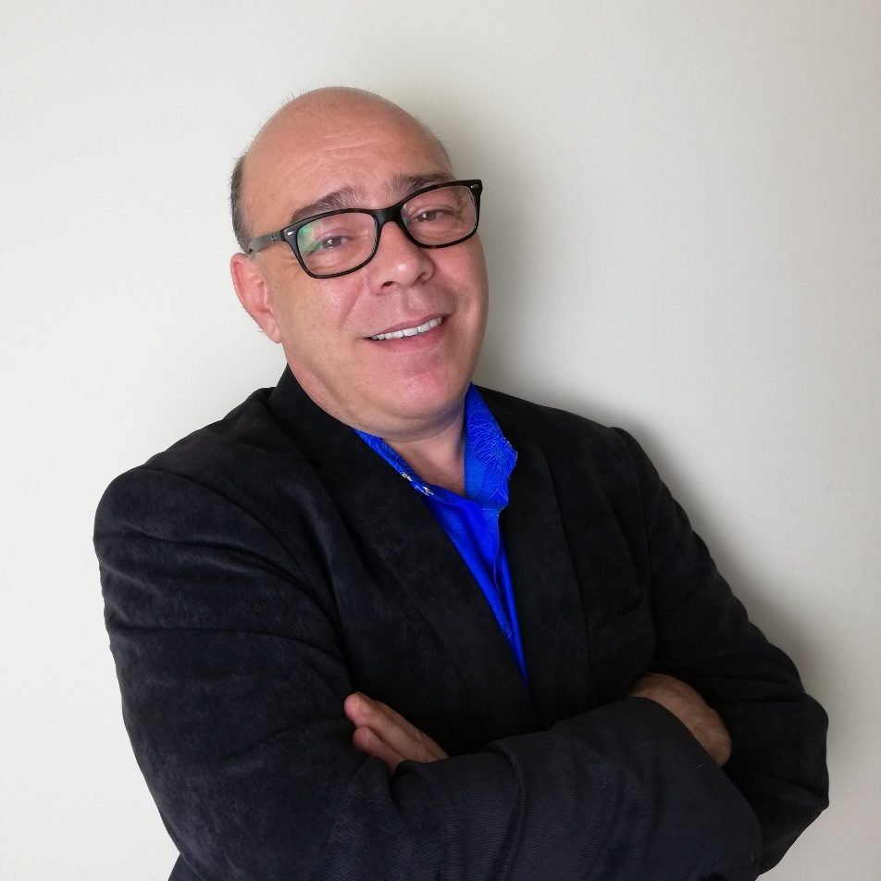
THANK YOU!
For more information,
please follow me on my Instagram:
@Richard.4.English
Or visit my website:
www.richard4english.com

