Slide 1
MMag. Esther Drexler, BEd. ERASMUS+ Support Officer, Lecturer
University College of Teacher Education Vienna

Slide 2
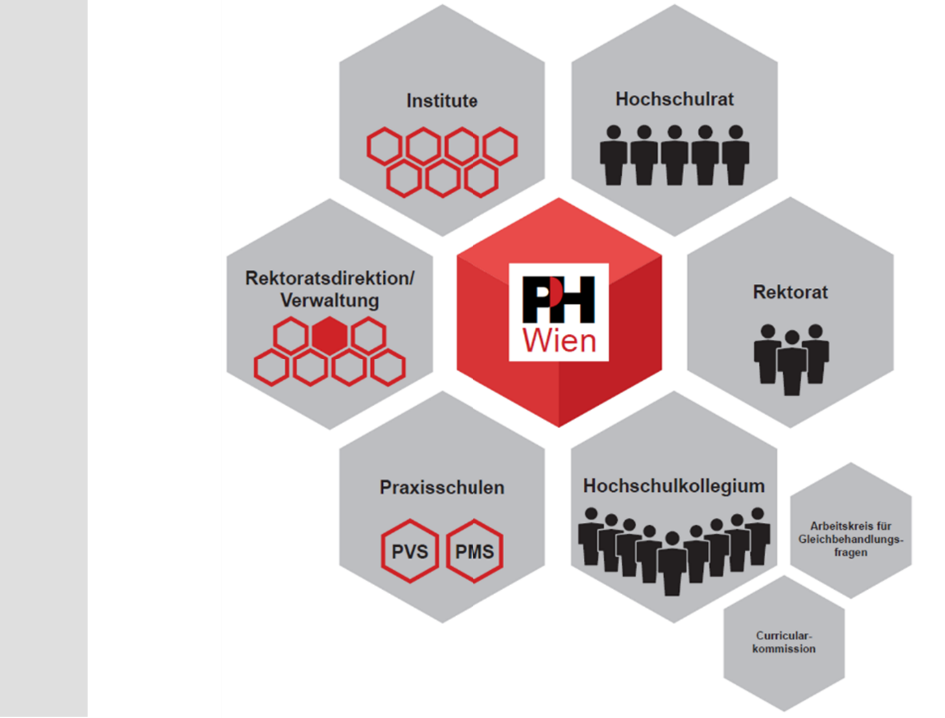
Departments
University College Council
Head of Administration/ Administration
Principal and Vice-principals
University College of Teacher Education Vienna
Schools for Pre-service
Classroom Teaching
Academic Senate
Equal Opportunities
Working Group
(Primary and lower secondary schools)
Curricular Affairs Committee
Notes:
Greller decided on Principal/Vice-principal/Principal‘s Office, accepted by IL Strasser
2

Slide 3
Target groups
Primary school teachers
Academic secondary school teachers and vocational school teachers
Annual number of participants:
40.000
Approx. 2.200 professional development courses and training seminars a year
Training and Continuing Professional Development
2.700 teaching professionals in Education, Training and Continuing Professional Development
Notes:
3

Slide 5
Department of General Secondary Education (IAS)
Department of Vocational Education (IBB)
Department of Educational Sciences and Practical Studies (IBG)
Department of Interdisciplinary Education (IBS)
Department of Elementary and Primary Education (IEP)
Departments
Department of University College Management (IHM)
Department of Continuing Professional Development and Educational Cooperation (IWQ)
Notes:
Official translation –approved by PH
5

Slide 6
Study Program at a Glance
Bachelor and Master Studies Primary Level Teacher Education
Focus areas
Integrated Education/ Special Needs Education
Creativity
Science and Health
Language Education
Bachelor Studies
General Secondary Level Teacher Education
North-East (cluster)
Study Program

Slide 7
Study Program at a Glance
Bachelor Studies
Vocational Education
Teacher Education
Secondary Level Vocational Education
Field of study
Nutrition (E)
Information and Communication (IK)
Fashion and Design (MD)
Part-time Vocational Education and Apprenticeship (dual training) including Engineering and Industrial Arts (DATG)
Relevant Special Studies/ Supplementary Studies (FESE)
Other
educational fields:
University College Course Leisure Education
Study Program
Notes:
Dual Vocational Training as well as Technology and Trade vs (Flyer). Engineering and Industrial Arts (DATG) Part-time Vocational Education and Apprenticeship (dual training) including
Please reconcile the differences between the Flyer and PPP
Part-time Vocational Education and Apprenticeship (dual training) according to the Key Education System (BMB)
7

Slide 8
Primary Level Teacher Education
Bachelor Studies (BEd)
8 semesters
240 ECTS-credits
Practical Studies
Commencing from the 1st semester
Master Studies (MEd)
2 semesters
60 ECTS-credits
Semester(s) abroad
Erasmus+
Notes:
8

Slide 9
Professional field
Primary Level Teacher Education (Primary School)
Primary Level Teacher Education
Bachelor Studies admission requirements
Compulsory “Reifeprüfung” or diploma examination
General eligibility
Successful completion of the eligibility procedures
Master Studies admission requirements
Successful completion of Bachelor Studies Primary Level (240 ECTS)
Notes:
Compulsory Reifeprüfung or diploma examination – taken from BMB Key Education System
9

Slide 10
Bachelor Studies (BEd)
8 semesters
240 ECTS-credits
Master Studies (MEd)
3 semesters
90 ECTS-credits
Primary Level Teacher Education Focus area: Integrated Education/ Special Needs Education
Practical Studies
Commencing from the 1st semester
Semester(s) abroad
Erasmus+
Notes:
Bachelor‘s Degree Programme (Flyer) vs. Bachelor Studies (PPP) etc. – IL Strasser chose the shorter version
Please reconcile the differences between the Flyer and PPP
10

Slide 11
Research ensures quality and scientific impact of learning.
University College of Teacher Education Vienna initiates, co-ordinates, supervises, and implements scientific and profession-oriented research within the context of relevant environments.
At the University College of Teacher Education Vienna research is based on the teaching professionals´ expertise.
Education programs are developed according to the assessed needs arising from the interplay of teaching, research and development.
Research and Development
Pre-service teacher education and practical studies constitute the key elements of research projects.
Teaching and Learning are largely based on research and practical studies.
Notes:
11

Slide 12
Inclusive Education Office (BIB)
Center for Didactics of Text and Information Literacies (DiZeTIK) Health
Promotion
Center (GFZ)
Competence Center for Multilingualism and Migration (Ko.M.M.) Regional Educational Competence Center Sciences and Mathematics (RECC NaWiMa) Center for Educational Technology and Innovation (ZLI) Center for Civic Education (ZPB)
Center for Professional Advice on School Development Processes
(ZSB)
Interdisciplinary fields of educational expertise
Centers
Notes:
IL Walter Swoboda to discuss it with the team and send the translations back – done, approved by IL Strasser
ZLI Logo to be changed
12

Slide 13
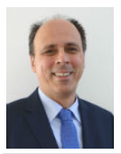
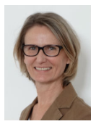
95 partner institutions
International Office
International networking – for the benefit of students, graduates, teaching and administrative professionals.
International mobility
Mag. Dr. Thomas BAUER Head of the International Office, Erasmus+ Coordinator
Mag. Birgit HÖFLER, BEd. Deputy Head, Teachers and Staff Mobility
Notes:
13

Slide 14
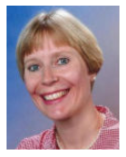
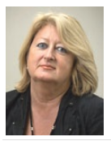
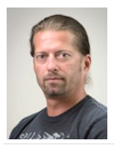
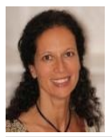
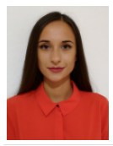
Mag. Brigitte ROTH Erasmus+ Support Outgoing Students
Dipl.-Päd. Eva SMITH, BEd. Erasmus+ Support Incomings (EU countries)
Mag. Alexandra ALBRICH Outgoing Students and Trainee Mobility (VE)
Dipl.-Päd. Sylvia SCHULZ Erasmus+ Support Outgoing Students
International Office Team
Dipl.-Päd. Holger WINKELMAIER, BEd. Erasmus+ Support Incomings (non EU)
MMag. Esther DREXLER, BEd. Erasmus+ Support Student Mobility and Homepage
Dipl.-Päd. Mag. Nicoletta GLANZNER Erasmus+ Support Outgoing Students
Mag. Miriam WAGENHOFER Administrative Trainee
Mgr. Martina BENIKOVA Erasmus+ Assistant
Notes:
14

Slide 15
Contracts
KA 103
Regulate individual mobilities between programme countries
KA 107
Regulate individual mobilities between partner countries
Ukraine and New Mexico
Contracts and projects
Bilateral agreements with universities
Interim and final report for the National Agency
Notes:
15

Slide 16
Ukraine
Staff and student mobility with universities in Lwiw and Drohobytsch
Staff mobility with university in Ternopil and current establishment of an International Programme for students
Contracts and projects
Notes:
16

Slide 17
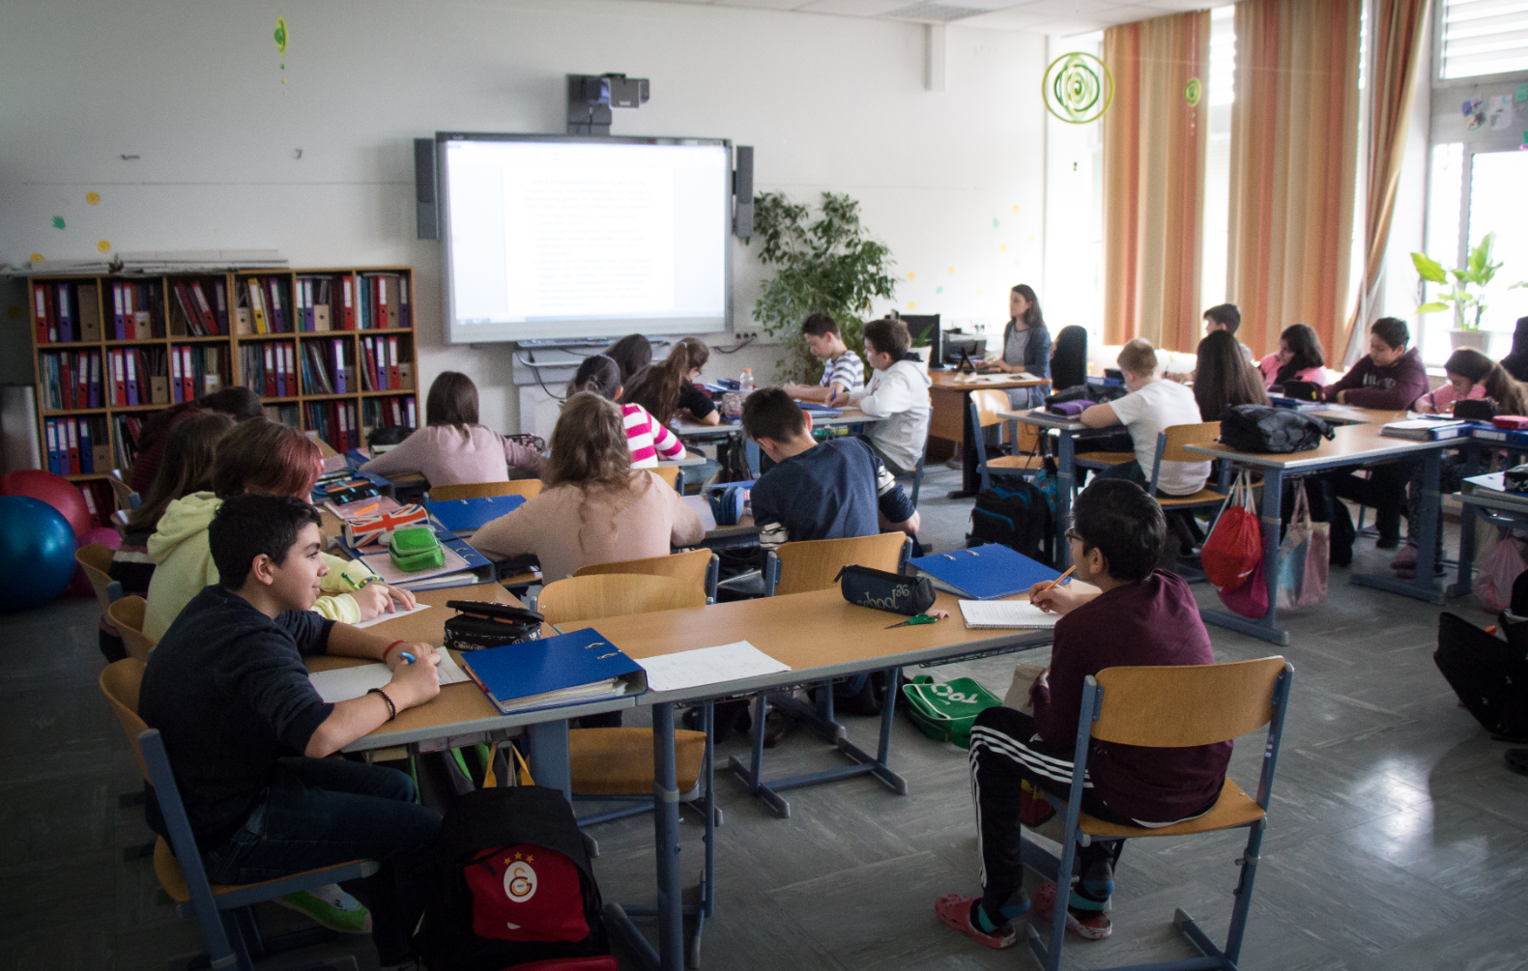
Projects
Practically orientated projects and research projects between partner universities
One coordinating institution and several host partners
Joint work on a topic
Contracts and projects
Notes:
17

Slide 18
International Projects:
https://www.phwien.ac.at/university-college-of-teacher-education-overview/international-projects
InOut Project:
https://inouterasmus.wixsite.com/resources
ReCreaDe Project:
https://www.recreade-erasmus.eu/
Projects
Notes:
18

Slide 19
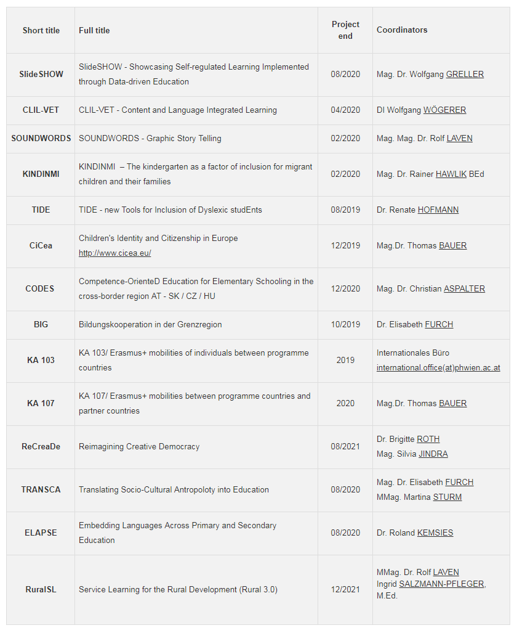
Projects
Notes:
19

Slide 20
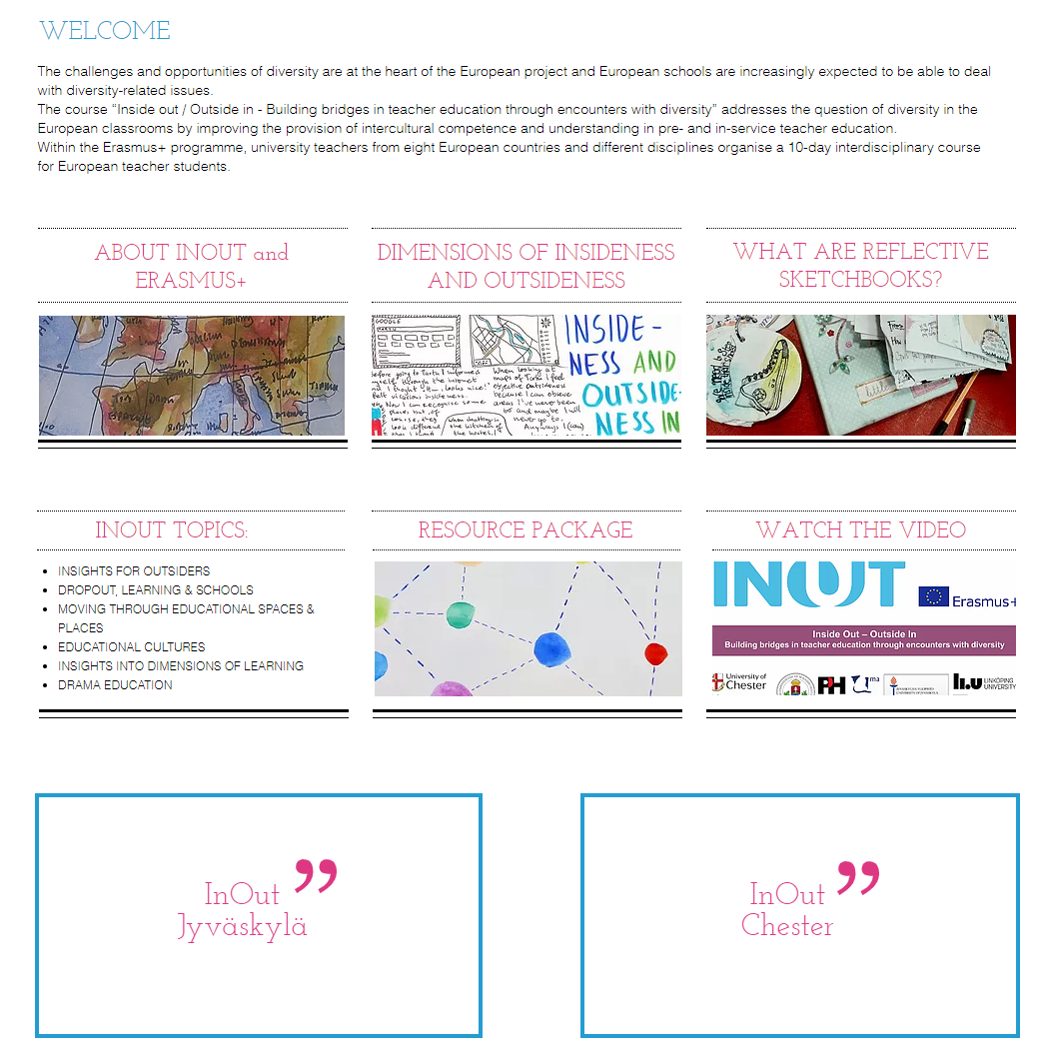
InOut
Challenges and opportunities of diversity https://inouterasmus.wixsite.com/resources
Notes:
20

Slide 21
ReCreaDe
Democracy and Diversity in the context of education https://www.recreade-erasmus.eu/
Notes:
21

Slide 22
Semester(s) abroad during the course of study within the 3rd to 8th semester
Prerequisite is a good course of study without residues
Outgoing Students
Duration from three to a maximum of twelve months
Application in the International Office

Slide 23
Preparation of a Learning Agreement in advance
Transcript of Records of partner university confirms attended courses
Full recognition of studies acquired abroad
Outgoing Students

Slide 24
Learning Agreement:
https://www.phwien.ac.at/internationale-mobilitaet-und-kooperation/auslandspraktika/allgemeinbildung
Outgoing Students

Slide 25
95 partner universities to choose
Western Europe Belgium Great Britain Netherlands France Ireland
Central Europe Germany Switzerland Hungary Czech Republic Slovakia
Northern Europe Denmark Finland Iceland Norway Sweden
Partner Universities

Slide 26
95 partner universities to choose
Eastern Europe Estonia Latvia Lithuania Poland Ukraine Russian Federation
Southeastern Europe Greece Romania Bulgaria Turkey Cyprus
Southern Europe Italy Slovenia Croatia Spain
Partner Universities

Slide 27
95 partner universities to choose
Partneruniversities: https://www.phwien.ac.at/internationale-mobilitaet-und-kooperation/outgoing-students
Partner Universities

Slide 28
Work placements abroad for students at the Institute for Vocational Education and Training
Free choice of internship position
in 33 countries throughout Europe
Full recognition of compulsory internships
Trainee Mobility

Slide 29
Preparation of a Learning Agreement
Nomination at the National Agency and conclusion of a student contract
Confirmation and Traineeship Certificate at the end of the stay
Mandatory online language assessment (OLS) and online language course
Trainee Mobility

Slide 30
Graduate internships
Internships abroad after completion of studies
Trainee Mobility
Completion within the first year after graduation

Slide 31
Application in the International Office in the last semester of the study period
Free choice of an internship position
in 33 countries
Trainee Mobility

Slide 32
Duration of study visits at least three full months
Duration of compulsory and graduate internships at least two full months
A maximum of twelve months per study cycle, incomplete months are calculated on a daily basis
Outgoing Students and Trainee Mobility

Slide 33
Teaching Staff Mobilities
Teaching and Training Staff Mobility
Training Staff Mobilities

Slide 34
The duration of stay is two days to two months
The University College of Teacher Education supports stays abroad in the sense of international knowledge transfer
95 partner institutions can be visited
Teaching and Training Staff Mobility

Slide 35
Staff Mobility for Training
Lecturers and staff
Individual training in the areas of administration and research
Language courses
Teaching and Training Staff Mobility
Staff Mobility for Teaching
Lecturers only
Teaching at a foreign university

Slide 36
Outgoing
Mobility Agreement for Teaching/ Training
Grant Agreement and Nomination
Approval of internal travel request
Letter of Confirmation
Report
Survey
Cost accounting
Teaching and Training Staff Mobility
Incoming
Mobility Agreement
Compilation of a program flow
Letter of Confirmation

Slide 37
Students from abroad spend one semester studying abroad at the University College of Teacher Education
Incoming Students
International Office provides help and information

Slide 38
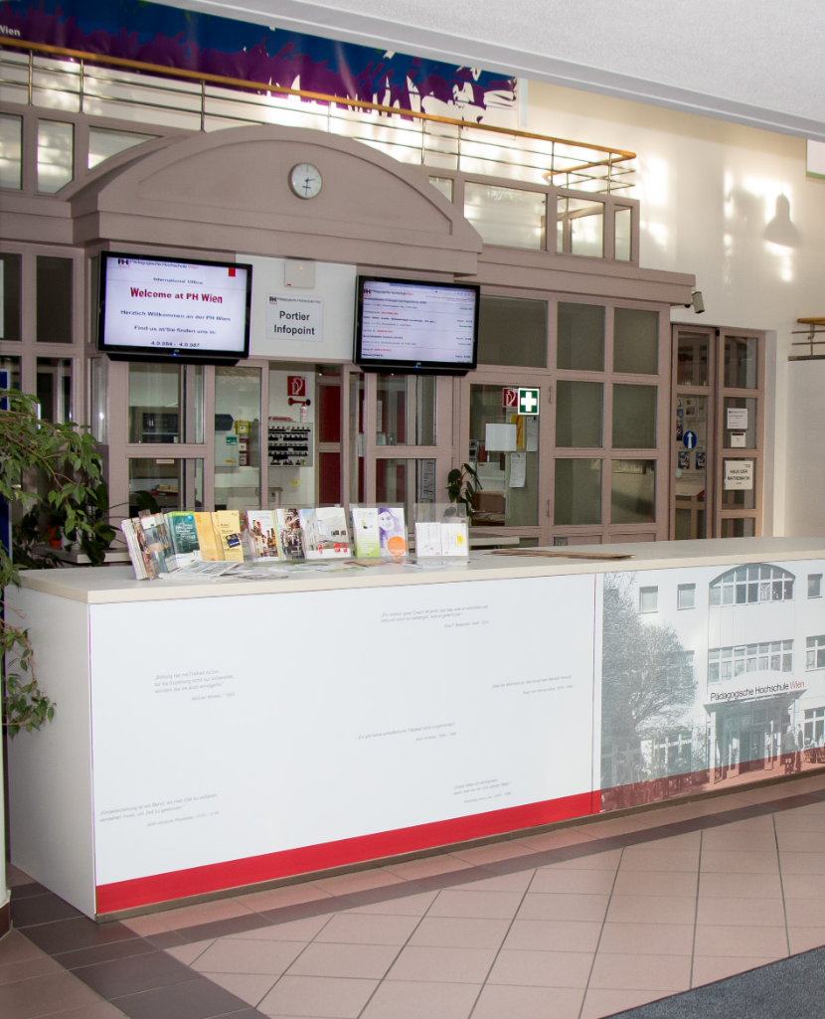
Application deadlines for sending universities 01.09.-15.11. for summer 01.03.-15.05. for winter
Information and welcome package before arrival
Incoming Students
Buddy service by students of the University College of Teacher Education
Arrival Service

Slide 39
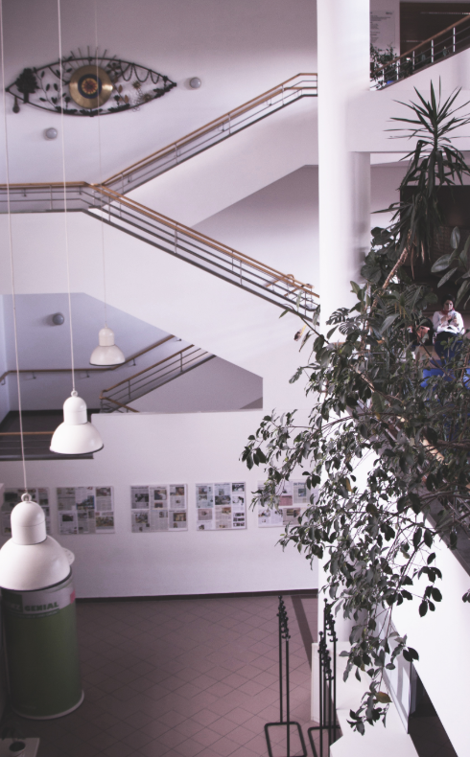
Orientation week before beginning of semester
Incoming Students
International Programme with special courses for incoming students

Slide 40
Incoming Students

Slide 41
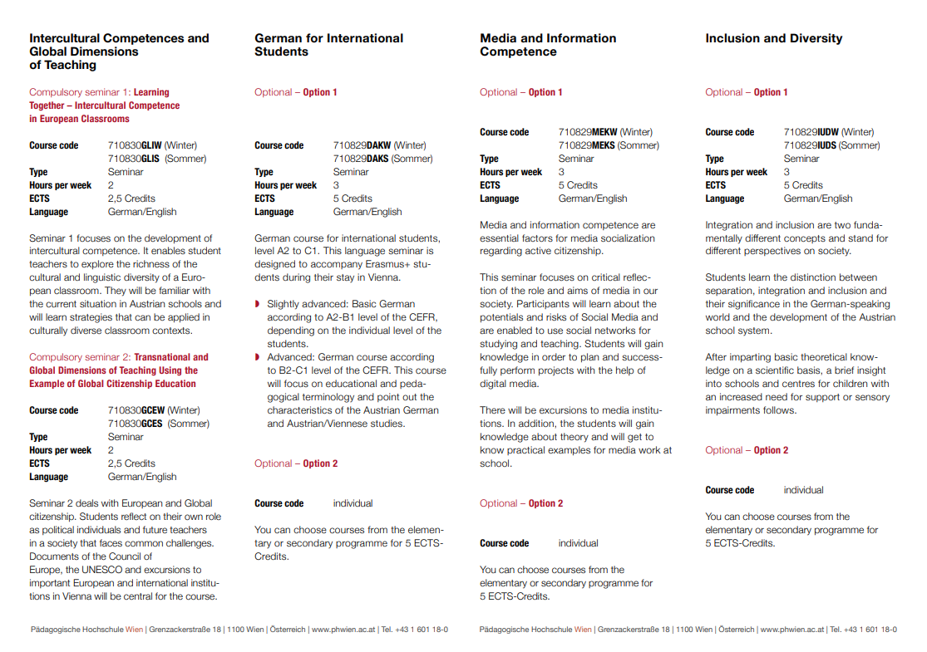
Incoming Students

Slide 42
Findings from the Erasmus Impact Study (EIS) and the effects on employability
85% take part in order to improve their employability
64% of employers expect international experience
99% improve confidence and adaptability
50% reduced probability of later unemployment
44% increased probability to get a management position later
Erasmus+ Impact Study (EIS)

Slide 43
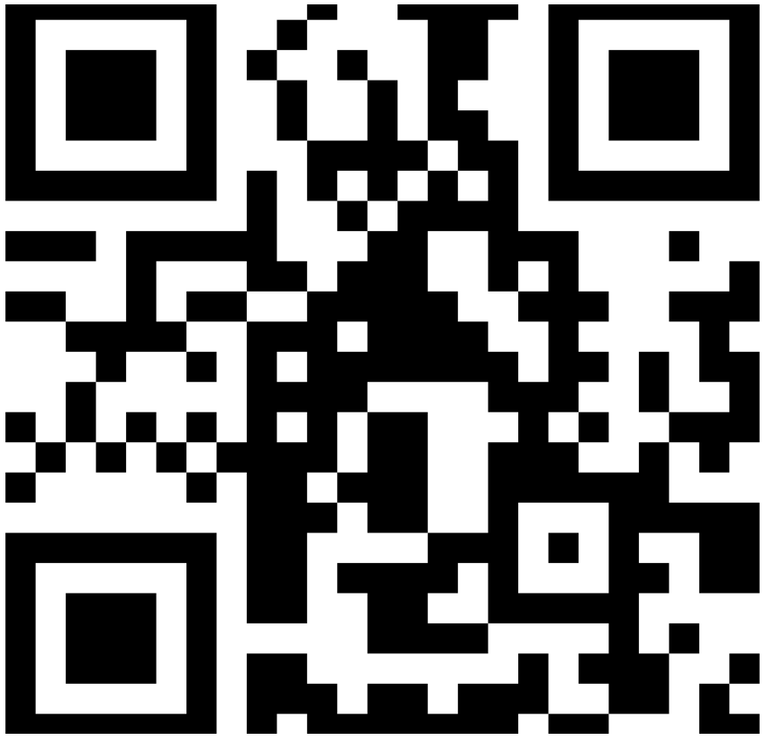
For further information
www.phwien.ac.at/en

