Slide 1
The role of the DAAD in the process of internationalisation of higher education institutions
André Böhm
DAAD-Lektorat Luzk
daad.boehm@gmail.com

Slide 2
General information
Organisation of the universities (241) and student organisations (104) in Germany
Worldwide the largest organisation engaged in the promotion and development of academic cooperation
Mediatory organisation in the field of foreign cultural politics, educational and scientific politics and the development cooperation
Most important stakeholder in the sphere of the internationalisation of higher education institutions, of the higher education sphere and university and research marketing

Slide 3
Erste Ebene
Zweite Ebene
Dritte Ebene
DAAD supports academic exchange in three areas:
scholarships for the „best“ students, graduates and scientists
structures for internationalisation
expertise for academic collaborations

Slide 4
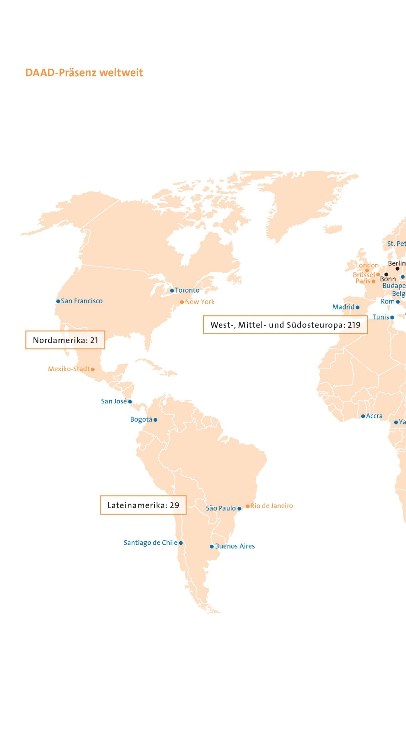
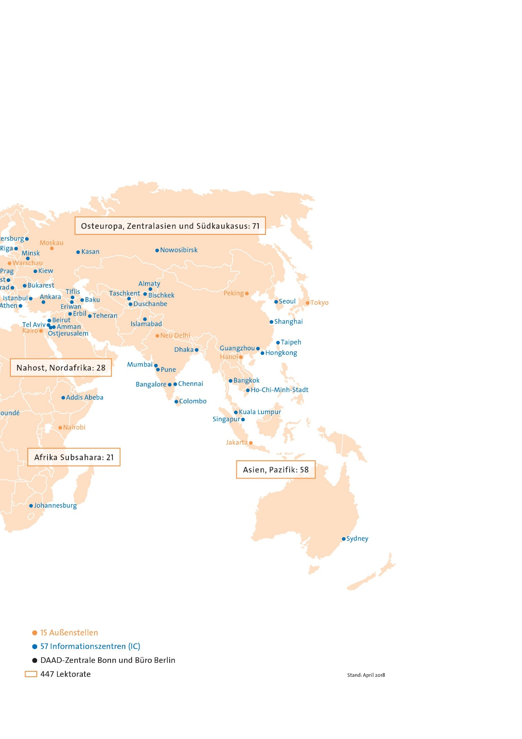
DAAD worldwide
Bonn / Berlin
15 Regional Offices
56 Information centres
447 lecturers

Slide 5
DAAD in Ukraine
Erste Ebene
Zweite Ebene
Dritte Ebene
Луцьк
Суми
Київ
Львів
Харків
Дніпро
Чернівці
Одеса
Миколаїв
1 information centre
13 lecturers
1 Fachlektor
1 long-term professor
3 language assistants

Slide 6
Dates and figures
founded (by students!) in 1925, re-founded in 1950
“Bildungsausländer“ vs. “Bildungsinländer“
359000 international students (12,8 %) – 5 % than 2016
9613 Ukrainians (2,6% / 9. position)

Slide 7
Dates and figures
 | 1950 | 1990 | 2010 | 2017
Scholars | 426 | 38883 | 105886 | 139758
... from Germany | 196 | 21974 | 42097 | 61528
… from other countries | 230 | 16909 | 63807 | 78230
Budget | 75 | 134590 | 383977 | 522035
Member universities | (62) | 189 | 234 | 241
Student bodies | 99 | 174 | 124 | 104
Selection commission: members |  | 474 | 584 | 477

Slide 8
Dates and figures – Scholarships Ukraine (2017)
 | Ukrainian | German
Scholarships | 280 | 58
Projects | 1102 | 234
Erasmus Students | 196 | 13
Erasmus Staff | 81 | 20
total | 1659 | 325
1984

Slide 9
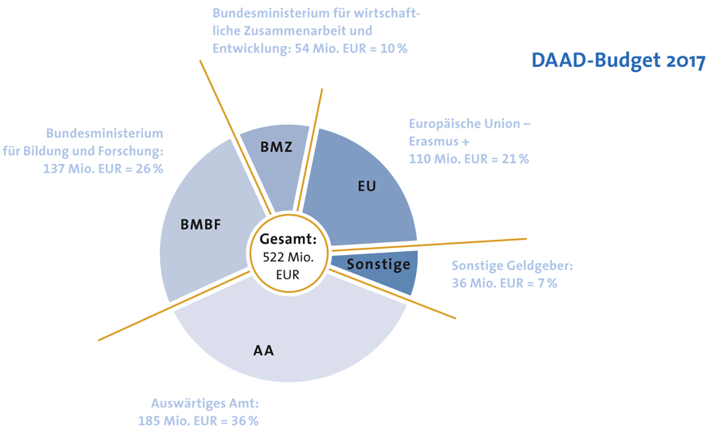
Dates and figures

Slide 10
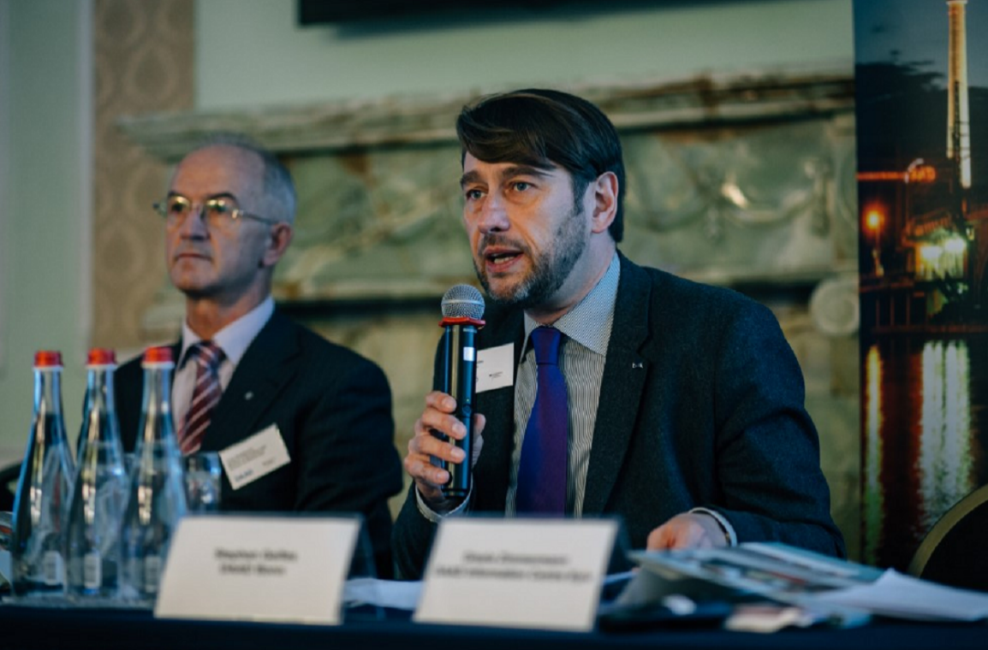
Spheres of activities
“German-ukrainian cooperative study programmes – one step to the internationalisation of Ukrainian universites“, Kyjiv (2017)
Internationalisation of universities
Internationalisation of research
Scholarships for students, graduates,
scientists
German language and German studies
Development cooperation
National Agency for EU Higher Education Cooperation
Transnational education
University and research marketing
Alumni acitivites (alumniportal-deutschland.org)

Slide 11
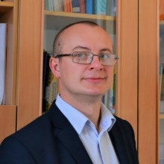
German language and German studies
DAAD lecturers and language assistants
“Schools – Partners of Future“ (“Partner der Zukunft“, PASCH)
Sur-Place professional courses
International congress of German teachers
Significance of German as a foreign language
Significance of German as a language of science
“Dhoch3“ (“D to the power of 3“, moodle.daad.de)
Johann- and Wilhelm-Grimm-Award
Lyubomyr Borakovsky
Ivan Franko University in Lviv
Jacob and Wilhelm Grimm Award for young specialists of German philology 2018

Slide 12
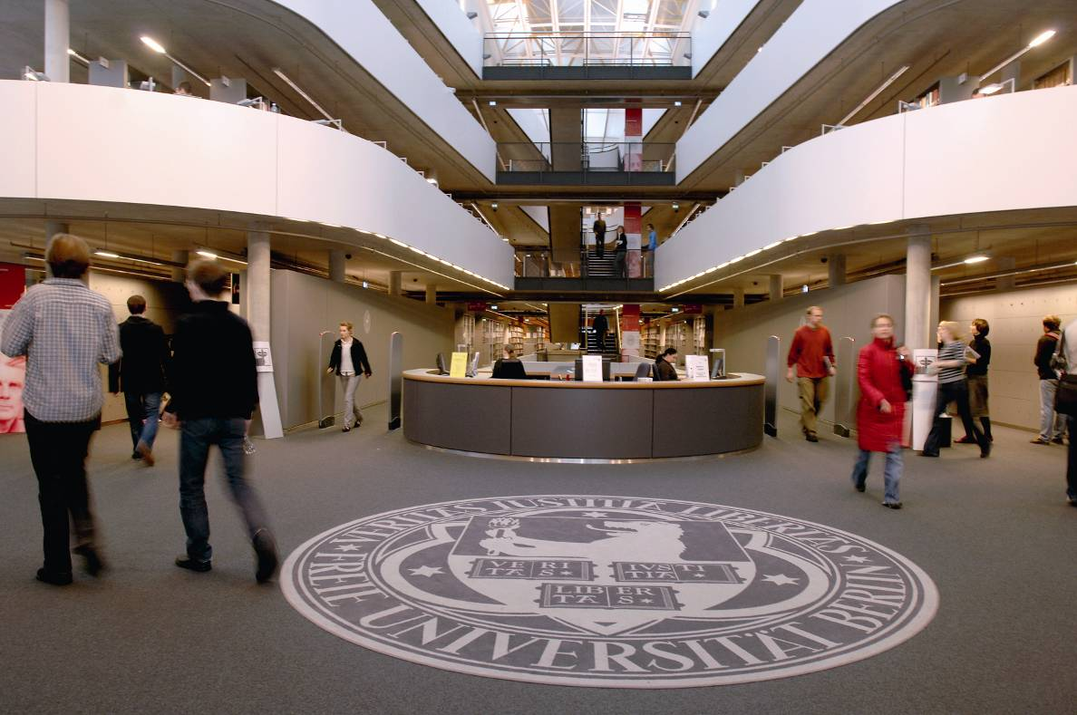
National Agency for EU Higher Education Cooperation
Federal Ministry of Education and Research (BMBF)
Erasmus ► mobility inside of Europe (since 1987)
Bologna process
“Mobility with partner countries“
“Europa macht Schule“ (“Europe goes to school“)
ASEM Education Process

Slide 13
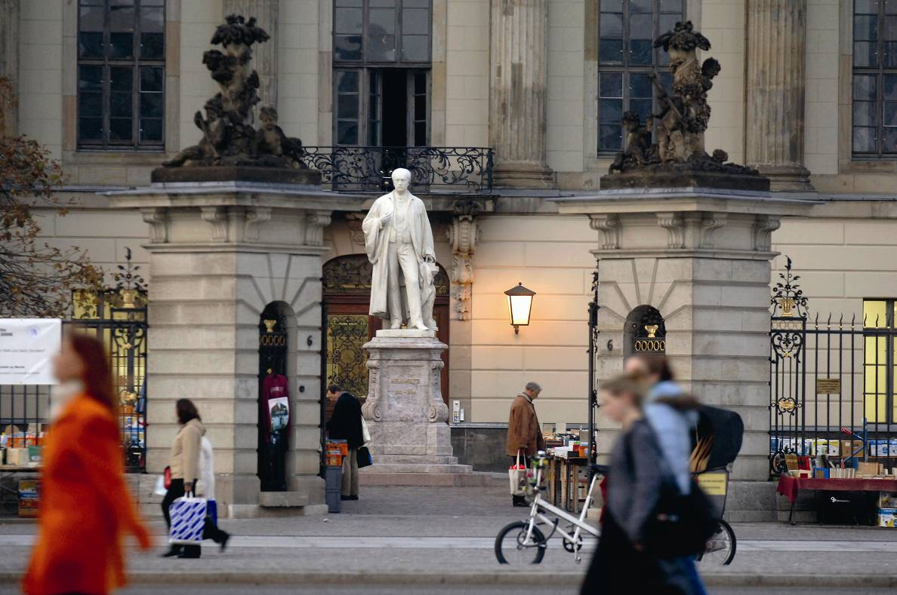
Transnational Education
German study programmes abroad (on over 60 locations in 34 countries)
Branch of study: two thirds “MINT”
German as a part of the obligatory curriculum (about 75%)
Part of the study programme in Germany

Slide 14
Transnational Education
binational universities as “lighthouse projects” of internationalisation
high reputation, important and attractive for a certain region
German universities as reliable partners and players
German University in Cairo (GUC), 2003
German Jordanian University (GJU) in Amman, 2005
German University of Technology (GUtech) in Maskat, Oman, 2005
Deutsch-Kasachische Universität (DKU) in Almaty, 1999
Vietnamese German University (VGU) in Ho Chi Minh City, 2008
Turkish German University (TDU) in Istanbul, 2006
Andrássy University Budapest (AUB), 2001

Slide 15
Transnational Education
financial means for Syrian refugees
“International Social Work with Refugees and Migrants“, GJU
“Culture preservation“, Helwan University (Cairo)

Slide 16
University and research marketing
conferences, congress
training programmes for university staff
education fairs
publicity
marketing campaign
GATE Germany – webinars, virtual fairs

Slide 17
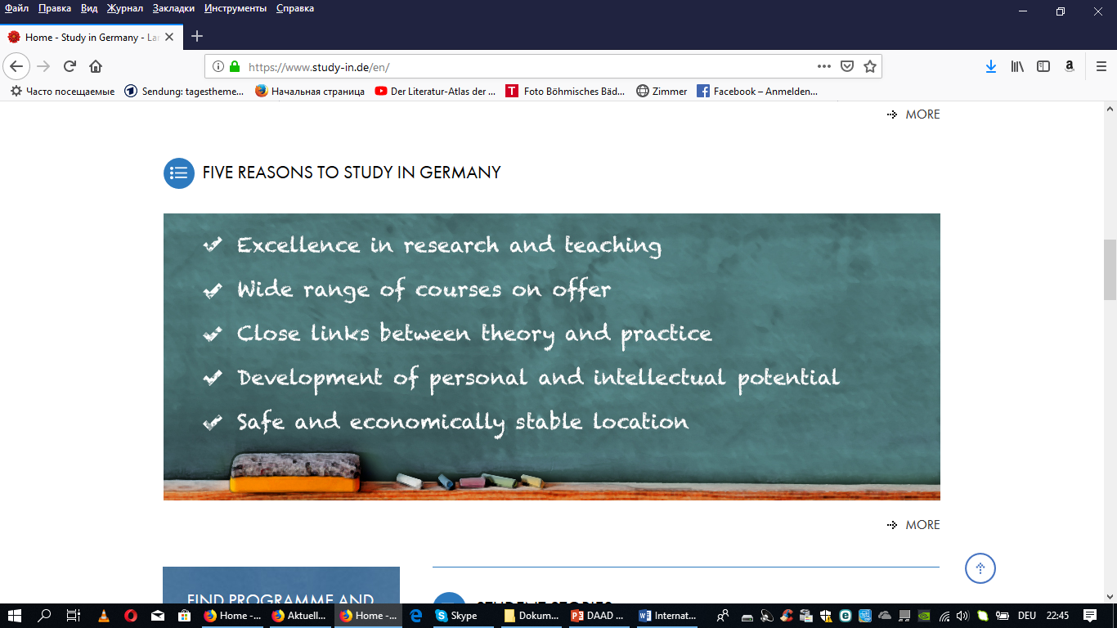
www.study-in.de

Slide 18
Programmes for Ukrainian universities
Support for the internationalisation of Ukrainian higher education institutions (2019-2021)
Continuing education programmes for administrators at Ukrainian higher education institutions in education and academic management
Shaping the digital future together: German-Ukrainian higher education institution collaborations
Deadline: 28 June 2019

Slide 19
Support programmes for Ukrainian universities
Go East Summerschools
Deadline: November

Slide 20
Challenges
Populism, Nationalism
“Alternative facts“ instead of scientific reality
Brexit
Integration of international students
trouble spots in the world: refugees, wars, political conflicts, persecution

Slide 21
Питання є ?

Slide 22
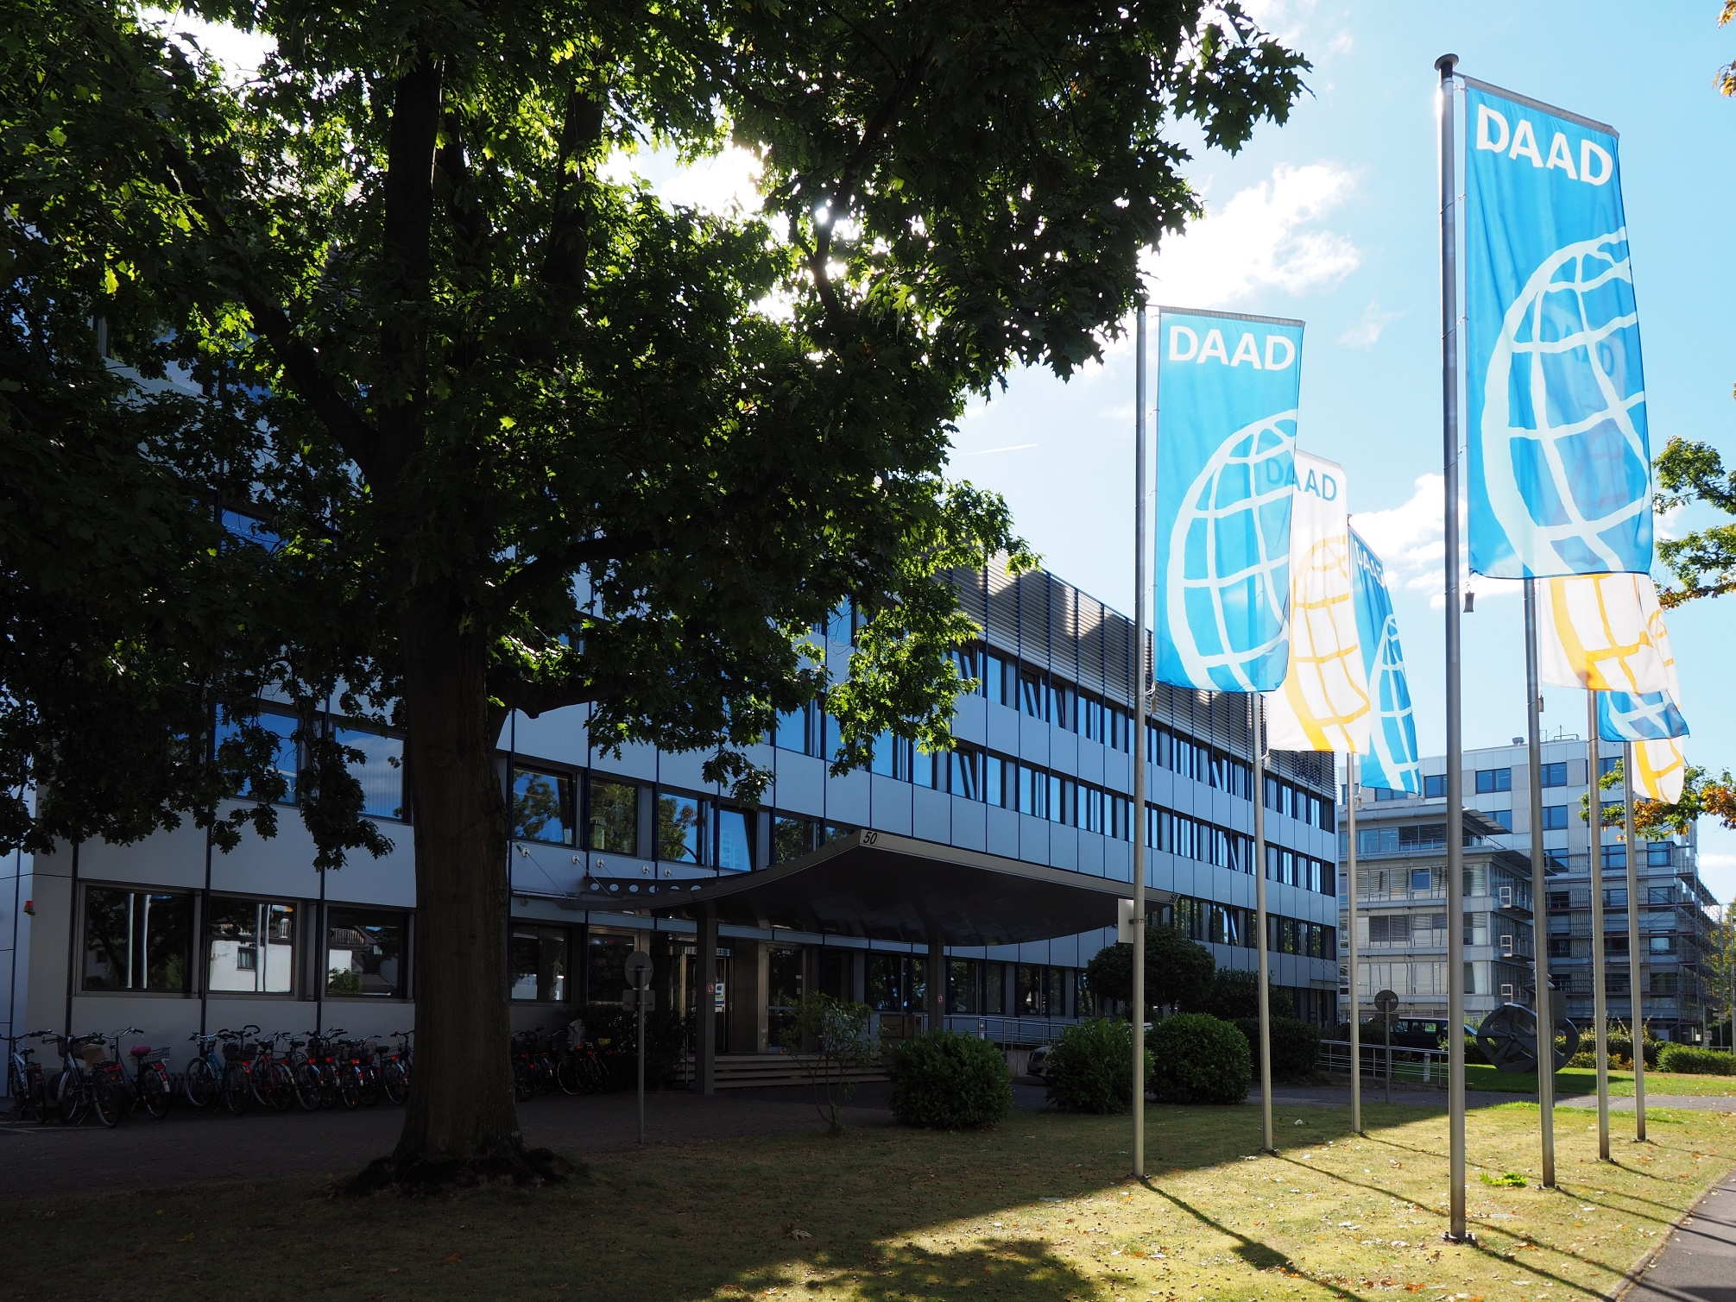
Дякую за увагу ! Vielen Dank für Ihre Aufmerksamkeit !

